Slide 1
Forces and Freebody Diagram Notes

Slide 2
The Meaning of Force
A force is a push or pull upon an object resulting from the object's interaction with another object.
Force is a quantity which is measured using the standard metric unit known as the Newton.

Slide 3
Types of Forces
Applied Force - F_{app}
An applied force is a force which is applied to an object by a person or another object.

Slide 4
Types of Forces
Gravity Force (also known as Weight) - F_{grav}
The force of gravity is the force with which the earth, moon, or other massively large object attracts another object towards itself.
Fgrav = m * g
where g = 9.8 m/s² (on Earth) and m = mass (in kg)

Slide 5
Types of Forces
Normal Force - F_{norm}
The normal force is the support force exerted upon an object which is in contact with another stable object.

Slide 6

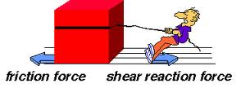
Types of Forces
Friction Force - F_{frict}
The friction force is the force exerted by a surface as an object moves across it or makes an effort to move across it.

Slide 7
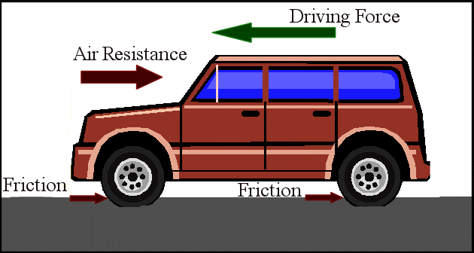
Types of Forces
Air Resistance Force - F_{air}
The air resistance is a special type of frictional force which acts upon objects as they travel through the air.

Slide 8
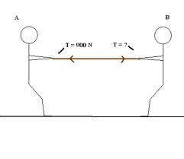
Types of Forces
Tension Force - F_{tens}
The tension force is the force which is transmitted through a string, rope, cable or wire when it is pulled tight by forces acting from opposite ends. The tension force is directed along the length of the wire and pulls equally on the objects on the opposite ends of the wire.

Slide 9
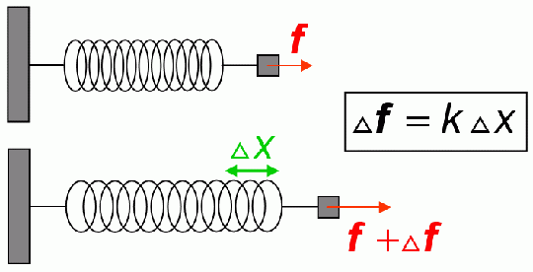
Types of Forces
Spring Force - F_{spring}
The spring force is the force exerted by a compressed or stretched spring upon any object which is attached to it. An object which compresses or stretches a spring is always acted upon by a force which restores the object to its rest or equilibrium position.

Slide 10
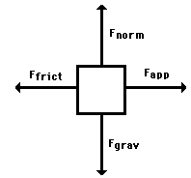
Drawing Freebody Diagrams
Free-body diagrams are diagrams used to show the relative magnitude and direction of all forces acting upon an object in a given situation.

Slide 11

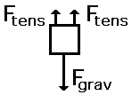


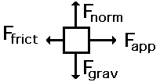
Practice with Freebody Diagrams
1. A book is at rest on a table top.
2. A girl is suspended motionless from the ceiling by two ropes.
3. An egg is free-falling from a nest in a tree. Neglect air resistance.
4. A flying squirrel is gliding (no wing flaps) from a tree to the ground at constant velocity. Consider air resistance.
5. A rightward force is applied to a book in order to move it across a desk with a rightward acceleration. Consider frictional forces. Neglect air resistance.

Slide 12
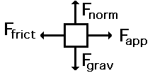

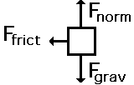
Practice with Freebody Diagrams
6. A rightward force is applied to a book in order to move it across a desk at constant velocity. Consider frictional forces. Neglect air resistance.
7. A college student rests a backpack upon his shoulder. The pack is suspended motionless by one strap from one shoulder.
8. A skydiver is descending with a constant velocity. Consider air resistance.
9. A force is applied to the right to drag a sled across loosely-packed snow with a rightward acceleration.
10. A football is moving upwards towards its peak after having been booted by the punter.
11. A car is coasting to the right and slowing down.

Slide 13
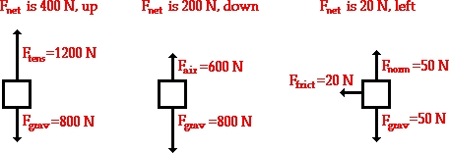
Determining Net Force
An object at rest tends to stay at rest and an object in motion tends to stay in motion with the same speed and in the same direction unless acted upon by an unbalanced force.

